Slide 1
Automatic Traffic Signal Control System
Using Deep Learning
By:-
Namasivaayam L (20BAD036)

Slide 2
Road Of Contents
01
02
03
Introduction
Module - 1
Module - 2
Vehicle Detection
Traffic Signal System
04
Conclusion

Slide 3
INTRODUCTION
In recent years, there has been a significant rise in the overall economic losses owing to increasing traffic congestion. For instance, the total time lost owing to traffic congestion in Japan in 2012 was approximately 5 billion hours per year. The economic loss in terms of total lost time is estimated to be approximately 10 trillion yen per year, and it is calculated by converting cash wages in 2012 to time. Therefore, there is a need to realize a traffic signal control system (TSCS) that automatically obtains a better control law considering multiple factors using deep reinforcement learning
You can delete this slide when you’re done editing the presentation.

Slide 4
Details Of Traffic Signal Control System (TSCS)
The TSCS proposed in this study has the following characteristics: • No information is transmitted between traffic signals. • Predicts information on adjacent signals by using changes in congestion within an intersection
Under the TSCS, the following contributions can be obtained By using DTA. • The number of trials and errors required for learning convergence does not increase. • Reduced latency by 33% in the learned model. • The least variation in learning results per experiment.

Slide 5
Flow Chart:
Video Capture
Detecting Vehicles
Using Arduino and Cameras
Using Object Detection
Algorithms
Manipulating Signal
Anticipating Decision
Implementing the decision
Using DRL to make a decision

Slide 6
BASE PAPER:
Title: Mastering Arterial Traffic Signal Control With Multi-Agent Attention-Based Soft Actor-Critic Model
Published Date: January 25,2023
Work Done:
We implement the attention mechanism in the actor and critic network to enhance traffic information extraction ability. More importantly, we are the first to apply the soft actor-critic (SAC) algorithm to train the arterial traffic control model to search more solution spaces
References:
C. Li, X. Ma, L. Xia, Q. Zhao, and J. Yang, “Fairness control of traffic light via deep reinforcement learning,” in Proc. IEEE 16th Int. Conf. Autom. Sci. Eng. (CASE), Aug. 2020, pp. 652–658.

Slide 7
MERITS & DE-MERITS:
MERITS:
Centralized training technique is important. A decentralized training method may lead to slow and unstable training results.
The communication module may not be useful when an algorithm applied the centralized training technique.
Moreover, the attention mechanism can notably help the A Light network and A Critic network extract useful information from large state-action spaces..
DE-MERITS:
We will explore how to combine the MASAC model and knowledge transfer so that we can train our MARL models in large-scale road networks with acceptable training time. C

Slide 8
Next PAPER:
Title: Traffic Signal Control System Using Deep Reinforcement Learning With Emphasis on Reinforcing Successful Experiences
Published Date: 28 November 2022
Work Done:
A traffic light control system based on the dual targeting algorithm, which incorporates reinforcement of successful experiences in multi-agent environments, with the aim of realizing a better traffic light control system.
References:
Ministry of Land, Infrastructure, Transport and Tourism, Ministry of Land, Infrastructure, Transport and Tourism Productivity Revolution Project.
Available: https://www.mlit.go.jp/common/001132350.pdf

Slide 9
MERITS & DE-MERITS:
MERITS:
TSCS that can learn effectively without information transfer between traffic signals to reduce the transfer cost.
Traffic flow simulation results show that the proposed method reduces the waiting time by more than 33% compared with similar TSCSs using DQN and multistep DQN.
The learning time to convergence is also shorter than that of the existing methods, indicating that the method is effective even when real-time learning is considered.
DE-MERITS:
on a small computer such as those expected to be installed at each traffic signal in a real environment, we are concerned about increased computation time and insufficient memory compared to existing methods.

Slide 10
Next PAPER:
Title: GAN and Multi-Agent DRL Based Decentralized Traffic Light Signal Control
Published Date: 2 FEBRUARY 2022
Work Done:
We develop a communication-efficient decentralized ATSC framework for traffic networks with multiple intersections, where each intersection only exchanges traffic statistics with its neighboring intersections. In particular, the proposed framework consists of a generative adversarial network (GAN) based algorithm for traffic data recovery, and a multi-agent deep reinforcement learning (DRL) based decentralized ATSC algorithm for traffic efficiency enhancement.
References:
R. Zhong, R. Xu, A. Sumalee, S. Ou, and Z. Chen, “Pricing environmental externality in traffic networks mixed with fuel vehicles and electric vehicles,” IEEE Trans. Intell. Transp. Syst., vol. 22, no. 9, pp. 5535–5554, Sep. 2021, doi: 10.1109/TITS.2020.2987832.

Slide 11
MERITS & DE-MERITS:
MERITS:
we observed the “greenwave” phenomenon that depicts the ability of the proposed algorithm in achieving collaboration among the neighboring intersections.
With a combination of GAN and multi-agent DRL, a novel ATSC framework that is capable of achieving decentralized training and decentralized execution was developed to collaboratively control the traffic light signals .
In particular, the proposed GDATSC algorithm reduced the average accumulated waiting time by 50% when compared with fixed-time scheduling under the dynamic traffic flow.

Slide 12
NEXT PAPER:
Title: Multi-Agent Transfer Reinforcement Learning With Multi-View Encoder for Adaptive Traffic Signal Control
Published Date: . 8, AUGUST 2022
Work Done:
We propose a multiagent transfer reinforcement learning method to enhance the performance of MARL for ATSC, which is termed as multi-agent transfer soft actor-critic with the multi-view encoder (MT-SAC).
References:
Ministry of Land, Infrastructure, Transport and Tourism, Ministry of Land, Infrastructure, Transport and Tourism Productivity Revolution Project.
Available: https://www.mlit.go.jp/common/001132350.pdf

Slide 13
MERITS & DE-MERITS:
MERITS:
A multi-view state encoder and a transfer learning paradigm with guidance are proposed to enhance the learning abilities of the agents
The multi-view encoder encodes the global state of the agents in the region by attention mechanism to generate the attention state.
The learning time to convergence is also shorter than that of the existing methods, indicating that the method is effective even when real-time learning is considered.
DE-MERITS:
we will consider other mechanisms that can facilitate collaboration in ATSC, for example, letting the agent generate a controllable language instead of the original state, action, or reward.

Slide 14
BASE PAPER:
Title: Neighborhood Cooperative Multiagent Reinforcement Learning for Adaptive Traffic Signal Control in Epidemic Regions
Published Date: 12, DECEMBER 2022
Work Done:
This paper models the ATSC problem as a networked Markov game (NMG), in which agents take into account information, including traffic conditions of it and its connected neighbors
References:
H. Wei, G. Zheng, V. Gayah, and Z. Li, “Recent advances in reinforcement learning for traffic signal control: A survey of models and evaluation,” ACM SIGKDD Explor. Newslett., vol. 22, no. 2, pp. 12–18, Jan. 2021.

Slide 15
MERITS & DE-MERITS:
MERITS:
Comparing the vehicles’ average travel time in the three networks, we find that the optimal results are all about 270, even in the synthetic scenario where vehicle density is the most significant
This finding shows that the vehicle densities in Jinan and Hangzhou have not reached saturation and can accommodate more vehicles.
We will focus on this issue by designing simulation environments with emergencies and control algorithms with high robustness that can deal with uncontrolled environmental conditions
DE-MERITS:
There are many reasons for traffic jams in the real-world environment. One is that the signal control strategy needs to be improved.

Slide 16
BASE PAPER:
Title: Neighborhood Cooperative Multiagent Reinforcement Learning for Adaptive Traffic Signal Control in Epidemic Regions
Published Date: 12, DECEMBER 2022
Work Done:
This paper models the ATSC problem as a networked Markov game (NMG), in which agents take into account information, including traffic conditions of it and its connected neighbors
References:
H. Wei, G. Zheng, V. Gayah, and Z. Li, “Recent advances in reinforcement learning for traffic signal control: A survey of models and evaluation,” ACM SIGKDD Explor. Newslett., vol. 22, no. 2, pp. 12–18, Jan. 2021.

Slide 17
MERITS & DE-MERITS:
MERITS:
Comparing the vehicles’ average travel time in the three networks, we find that the optimal results are all about 270, even in the synthetic scenario where vehicle density is the most significant
This finding shows that the vehicle densities in Jinan and Hangzhou have not reached saturation and can accommodate more vehicles.
We will focus on this issue by designing simulation environments with emergencies and control algorithms with high robustness that can deal with uncontrolled environmental conditions
DE-MERITS:
There are many reasons for traffic jams in the real-world environment. One is that the signal control strategy needs to be improved.

Slide 18
BASE PAPER:
Title: Intersection Management Protocol for Mixed Autonomous and Human-Operated Vehicles
Published Date: 10, OCTOBER 2022
Work Done:
This paper presents a novel embedding protocol that allows for safe and efficient operation of the Hybrid Autonomous Intersection Management (H-AIM) protocol concurrently with actuated and adaptive signal controllers.
References:
] T.-Chiu Au, S. Zhang, and P. Stone, “Autonomous intersection management for semi-autonomous vehicles,” Routledge Handbook of Transportation. Oxfordshire, U.K., 2015, p. 17.

Slide 19
MERITS & DE-MERITS:
MERITS:
Combinations of similar turning profile policies for CAVs and HVs provide the most consistent and predictable improvement across varied CAV market penetration percentages for H-AIM.
In contrast to the findings in [17], traffic scenarios that are based on real-world data suggest that combinations of more permissive turning profiles for CAVs and more restrictive ones for HVs are not preferable for H-AIM at low CAV market penetration percentages. This may be due to delays brought on by CAVs blocking lanes while waiting for a reservation.
Modern signal optimization techniques such as varying signal parameters by time of day and signal actuation are seemingly compatible with, and beneficial to, the H-AIM protocol. This seems to be especially true at low CAV market penetration percentages.
DE-MERITS:
There are many reasons for traffic jams in the real-world environment. One is that the signal control strategy needs to be improved.

Slide 20
BASE PAPER:
Title: Hybrid Recurrent Neural Network Modeling for Traffic Delay Prediction at Signalized Intersections Along an Urban Arterial
Published Date: January 25,2023
Work Done:
This paper studies the traffic delay prediction modeling for multiple signalized intersections along the Ala Moana Boulevard and Nimitz Highway in Hawaii. Several machine learning (ML) based approaches have been studied in the literature, and most of them focused on prediction accuracy rather than the end use of real-time control and implementation.
References:
B. M. Williams, P. K. Durvasula, and D. E. Brown, “Urban freeway traffic flow prediction: Application of seasonal autoregressive integrated moving average and exponential smoothing models,” Transp. Res. Rec., J. Transp. Res. Board, vol. 1644, no. 1, pp. 132–141, Jan. 1998

Slide 21
MERITS & DE-MERITS:
MERITS:
a new hybrid modeling method for traffic delay prediction suitable for real-time implementation was developed to eliminate drawbacks of current ML-based methods for signalized intersections.
The advantage of the developed hybrid modeling method is that it can capture both linear and nonlinear stochastic characteristics of multiple traffic features—traffic signal timings, traffic volume, travel delays, etc., and it is computationally efficient for real time implementation.
The effective use case of this approach can be fully understood during the implementation phase by utilizing the closed-loop control strategy, which is the authors’ ongoing work.
DE-MERITS:
Though the model is well-trained with historical data, it will be continuously updated based on the data collected, and the control parameters will be updated to ensure the model’s robustness to uncertainties.

Slide 22
BASE PAPER:
Title: Distributed Signal Control of Arterial Corridors Using Multi-Agent Deep Reinforcement Learning
Published Date: January 25,2023
Work Done:
To reduce arterial traffic delays, this paper develops an adaptive coordination control method based on multi-agent reinforcement learning (MARL). Most existing MARL-based methods rely on impractical assumptions to improve their performance in complex and dynamic traffic scenarios.
References:
M. Xu, J. Wu, L. Huang, R. Zhou, T. Wang, and D. Hu, “Network-wide traffic signal control based on the discovery of critical nodes and deep reinforcement learning,” J. Intell. Transp. Syst., vol. 24, no. 1, pp. 1–10, Jan. 2020

Slide 23
MERITS & DE-MERITS:
MERITS:
MARL converges slowly under normal circumstances due to non-stationarity, and parameter sharing during learning can solve this issue in ATSC.
We designed a more effective action setting using the lead-lag left-turn phase sequence, which is more suitable for real-world applications and greatly improves the flexibility of signal control strategies for agent learning.
We designed a more comprehensive reward function to prevent overflows between adjacent intersections within a short distance.
DE-MERITS:
The phase sequence was designed manually, while automatic decision-making by the agent is more desirable.

Slide 24
BASE PAPER:
Title: Adaptive Traffic Signal Control With Deep Reinforcement Learning and High Dimensional Sensory Inputs: Case Study and Comprehensive Sensitivity Analyses
Published Date: 11, NOVEMBER 2022
Work Done:
This paper is an adaptive traffic signal controller able to receive un-preprocessed high-dimensional sensory information such as GPS traces from connected vehicles and self-learn to minimize intersection delays.
References:
T. Tan, F. Bao, Y. Deng, A. Jin, Q. Dai, and J. Wang, “Cooperative deep reinforcement learning for large-scale traffic grid signal control,” IEEE Trans. Cybern., vol. 50, no. 6, pp. 2687–2700, Jun. 2019.

Slide 25
MERITS & DE-MERITS:
MERITS:
We employed a new state space definition that does not require pre-processing or expert knowledge to extract features.
We showed the advantage of directly feeding high-dimensional sensory inputs to the traffic signal controller and how it affects the controller’s strategy.
We showed the advantage of directly feeding high-dimensional sensory inputs to the traffic signal controller and how it affects the controller’s strategy.
DE-MERITS:
Creating a coordinated network of self-learning traffic signals is a challenging task due the creep in dimensionality of state action space.

Slide 26
BASE PAPER:
Title: Traffic Signal Optimization Based on Fuzzy Control and Differential Evolution Algorithm
Published Date: 12, DECEMBER 2022
Work Done:
This paper combines the fuzzy control theory with the adaptive sequencing mutation multi-objective differential evolution algorithm (FASM-MDEA).
References:
S. Liu, Y. Li, Y. Qiu, B. Zhang, S. Qiu, and X. Liu, “Signal timing optimization algorithm for an intersection connected with an urban expressway,” Arabian J. Sci. Eng., vol. 45, no. 10, pp. 8667–8684, Oct. 2020.

Slide 27
MERITS & DE-MERITS:
MERITS:
By detecting the fleet length in each entrance lane, we used the fuzzy time series to predict the traffic flow in each direction of the next cycle, and we selected the appropriate timing scheme for the next cycle according to the traffic flow data to determine the optimal phase sequence arrangement.
we used the multi-objective DEA to optimize the fuzzy controller.
We will focus on this issue by designing simulation environments with emergencies and control algorithms with high robustness that can deal with uncontrolled environmental conditions
DE-MERITS:
There are many reasons for traffic jams in the real-world environment. One is that the signal control strategy needs to be improved.

Slide 28
Module - 1
Video Capture
Using Arduino and Cameras
Detecting Vehicles
Using Object Detection
Algorithms
Anticipating Decision
Using DRL to make a decision
Manipulating Signal
Implementing the decision

Slide 29
Driving center company profile infographics
STEP 1
STEP 2
STEP 3
TRACTION VEHICLE
ONE-WAY STREET
DRIVING LICENSE
Jupiter is a gas giant and the biggest planet
Mercury is the closest planet to the Sun
Neptune is very far away from Earth

Slide 30
Driving center company profile infographics
STRATEGY ROADMAP
Q1 | Q2 | Q3 | Q4
 |  |  |  | TRAFFIC
 |  |  |  | ROAD SIGNS
 |  |  |  | CROSSWALKS
 |  |  |  | PARKING
 |  |  |  | PEDESTRIANS

Slide 31
Driving center company profile infographics
01
02
VENUS
JUPITER
Venus has a really beautiful name
Jupiter is the biggest planet
03
04
SATURN
EARTH
Saturn is a planet with several rings
Earth is the third planet from the Sun
05
06
NEPTUNE
MARS
It’s the farthest planet from the Sun
Mars is actually a very cold place

Slide 32
Driving center company profile infographics
ATTENTION!
DON’T DRINK
NO PHONE
CAR CHECK
Venus has a really beautiful name
Jupiter is the biggest planet of them all
Saturn is a planet with several rings

Slide 33
Driving center company profile infographics
WHAT TO DO IN CASE OF AN ACCIDENT
01 | STOP THE CAR | Mercury is very small
02 | CALL THE POLICE | Venus is very hot
03 | TAKE PHOTOS | We all live on Earth
04 | DESCRIBE THE ACCIDENT | Mars is a red planet
05 | FIND WITNESSES | Jupiter is a big planet
06 | CALL A LAWYER | Saturn has beautiful rings

Slide 34
Driving center company profile infographics
DOS
DON’TS
Jupiter is a gas giant and the biggest planet
Mercury is the closest planet to the Sun
Venus is the second planet from the Sun
Earth is the third planet from the Sun
Neptune is the farthest planet from the Sun
Despite being red, Mars is a cold place
Saturn is a gas giant and has several rings
Ceres is located in the main asteroid belt

Slide 35
Driving center company profile infographics
01
MECHANICAL CHECK
Venus has a beautiful name
02
VISUAL INSPECTION
Jupiter is the biggest planet
03
VEHICLE HISTORY
Saturn is a planet with rings

Slide 36
Driving center company profile infographics
50%
75%
25%
LIGHT BULBS
HEADLIGHTS
TURN SIGNALS
Jupiter is a gas giant and the biggest planet
Mercury is the closest planet to the Sun
Venus is the second planet from the Sun

Slide 37
Driving center company profile infographics
HOW TO CHANGE A TYRE
01
02
03
PLACE JACK
REMOVE NUTS
SLIDE WHEEL
Venus has a really beautiful name
Jupiter is the biggest planet of them all
Saturn is a planet with several rings

Slide 38
Driving center company profile infographics
HOW TO CHANGE A TYRE
04
05
06
SET ASIDE
SPARE TYRE
SCREW NUTS
Venus has a really beautiful name
Jupiter is the biggest planet of them all
Saturn is a planet with several rings

Slide 39
Driving center company profile infographics
DRIVING CENTER |  | FIRST PAYMENT | SECOND PAYMENT | THIRD PAYMENT
 | THEORY | $1,000 | $2,000 | $2,000
 | PRACTICE | $1,000 | $1,500 | $3,000
 | TEST | $200 | $250 | $300

Slide 40
Driving center company profile infographics
A
REARVIEW MIRROR
Venus has a beautiful name
A
B
DRIVER MIRROR
B
Jupiter is the biggest planet
C
BLIND POINT
C
Saturn is a planet with rings

Slide 41
Driving center company profile infographics
TEST
Mercury is the closest planet to the Sun
DRIVING LICENSE
PRACTICE
THEORY
Jupiter is the biggest planet of them all
Despite being red, Mars is a cold place

Slide 42
Driving center company profile infographics
FAILED
20%
Venus has a really beautiful name
PASSED
80%
Saturn is a planet with several rings

Slide 43
Driving center company profile infographics
JAN | FEB | MAR | APR | MAY | JUN | JUL | AUG | SEP | OCT | NOV | DEC
THEORY
PRACTICE
TEST
Mercury is the closest planet to the Sun
Despite being red, Mars is a cold place
Jupiter is a gas giant and the biggest planet

Slide 44
Driving center company profile infographics
CENTER 1
Jupiter is the biggest planet of them all
CENTER 2
Despite being red, Mars is a cold place
CENTER 3
Mercury is the closest planet to the Sun

Slide 45
Driving center company profile infographics
MOST REQUESTED
01
CLASS D
Neptune is very far away from Earth
02
CLASS E
Mercury is the closest planet to the Sun
03
JUNIOR LICENSE
Despite being red, Mars is a cold place

Slide 46
Driving center company profile infographics
JANUARY
Mon | Tue | Wed | Thu | Fri | Sat | Sun
 |  |  |  |  | 01 | 02
03 | 04 | 05 | 06 | 07 | 08 | 09
10 | 11 | 12 | 13 | 14 | 15 | 16
17 | 18 | 19 | 20 | 21 | 22 | 23
24 | 25 | 26 | 27 | 28 | 29 | 30
31
01
02
CLASS A TEST
CLASS E TEST
Jupiter is a gas giant and the biggest planet
Mercury is the smallest planet of them all

Slide 47
Driving center company profile infographics
BASIC | PRO | PREMIUM | VIP
$1,215 | $2,225 | $2,995 | $3,995
Mercury is quite a small planet | Despite being red, Mars is a cold place | Saturn is a gas giant and has rings | Neptune is very far away from us

Slide 48
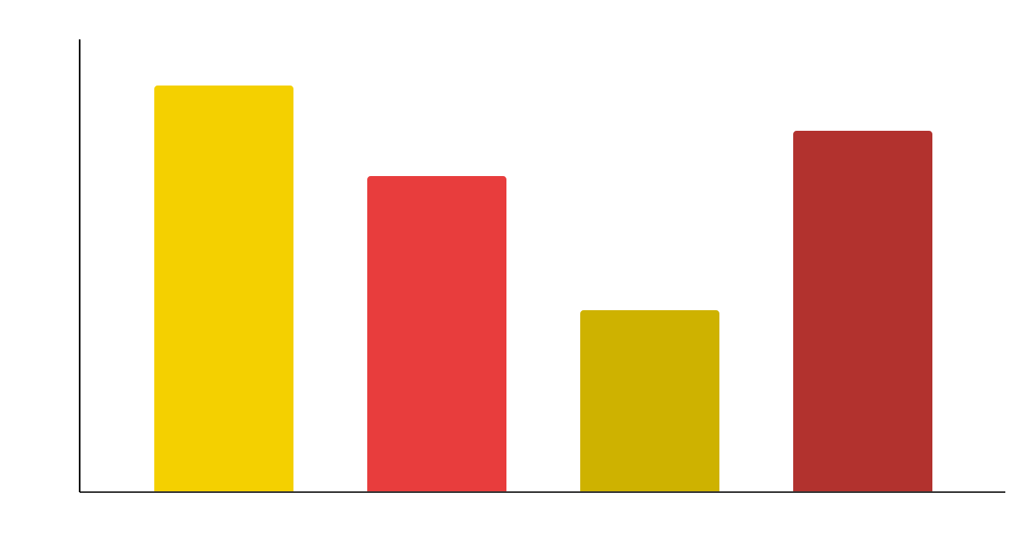
Driving center company profile infographics
CAR TUNING ESSENTIALS
Mercury is the closest planet to the Sun and the smallest one in the entire Solar System
90%
70%
40%
80%
Follow the link in the graph to modify its data and then paste the new one here. For more info, click here

Slide 49
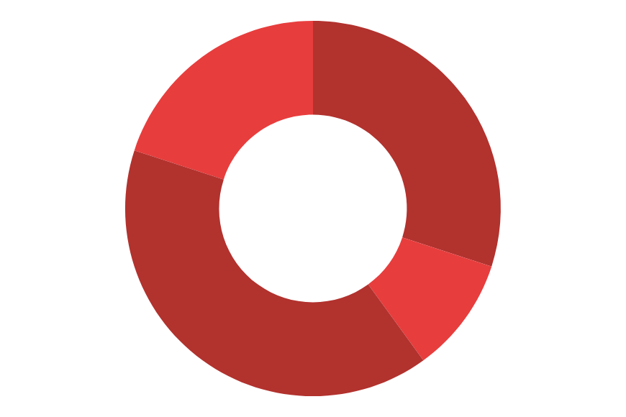
Driving center company profile infographics
Mercury is the closest planet to the Sun
Despite being red, Mars is a cold place
TRAFFIC SIGNS
DRIVING SKILLS
LICENSE
Jupiter is the biggest planet of them all
Earth is the third planet from the Sun
SENSE OF DIRECTION
MECHANICAL KNOWLEDGE
Follow the link in the graph to modify its data and then paste the new one here. For more info, click here

Slide 50
Driving center company profile infographics
VALVES
ENGINE BLOCK
Earth harbors life
TIMING BELT
OIL PAN
ENGINE PARTS
CHAMBER
Mars is very cold
SPARK PLUGS
PISTON
PISTON RING
Neptune is far away
CYLINDER

Slide 51
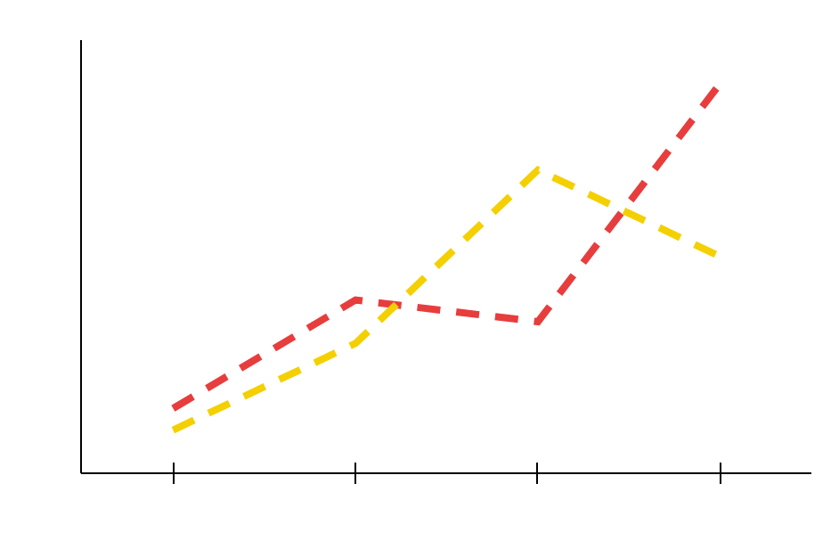
Driving center company profile infographics
CAR LICENSES
80%
Jupiter is a gas giant and the biggest planet
TRUCK LICENSES
50%
Pluto is considered a dwarf planet
Follow the link in the graph to modify its data and then paste the new one here. For more info, click here

Slide 52
Driving center company profile infographics
DRIVING INSTRUCTORS
GROUP A
GROUP B
Randy Pitman
Mercury is the closest planet to the Sun and the smallest one in the entire Solar System
Tony Sanchez
Benjamin Lean
Joann Kite
Dawn Murphy
Susan Tate
Rita Mendoza
Hazel Currey

Slide 53
Driving center company profile infographics
DRIVING LESSONS
Jupiter is the biggest planet of them all
THEORY
PRACTICE
MARS
MERCURY
VENUS
SATURN
Despite being red, Mars is a cold place
Mercury is the closest planet to the Sun
Venus is the second planet from the Sun
Saturn is a gas giant and has several rings

Slide 54
Driving center company profile infographics
01
02
CHARGING SYSTEM FUNCTIONING
CHARGING SYSTEM PROBLEMS
Jupiter is a gas giant and the biggest planet in the Solar System
Venus has a nice name and is the second planet from the Sun

Slide 55
Driving center company profile infographics
01
CAR
Jupiter is the biggest planet in the Solar System
40%
80%
02
03
TRUCK
MOTORCYCLE
Mercury is the closest planet to the Sun
Earth is the only planet that harbors life
10%

Slide 56
Instructions for use
If you have a free account, in order to use this template, you must credit Slidesgo in your final presentation. Please refer to the next slide to read the instructions for premium users.
As a Free user, you are allowed to:
- Modify this template.
- Use it for both personal and commercial projects.
You are not allowed to:
- Sublicense, sell or rent any of Slidesgo Content (or a modified version of Slidesgo Content).
- Distribute Slidesgo Content unless it has been expressly authorized by Slidesgo.
- Include Slidesgo Content in an online or offline database or file.
- Offer Slidesgo templates (or modified versions of Slidesgo templates) for download.
- Acquire the copyright of Slidesgo Content.
For more information about editing slides, please read our FAQs or visit Slidesgo School:
https://slidesgo.com/faqs and https://slidesgo.com/slidesgo-school

Slide 57
Instructions for use (premium users)
As a Premium user, you can use this template without attributing Slidesgo.
You are allowed to:
Modify this template.
Use it for both personal and commercial purposes.
Hide or delete the “Thanks” slide and the mention to Slidesgo in the credits.
Share this template in an editable format with people who are not part of your team.
You are not allowed to:
Sublicense, sell or rent this Slidesgo Template (or a modified version of this Slidesgo Template).
Distribute this Slidesgo Template (or a modified version of this Slidesgo Template) or include it in a database or in any other product or service that offers downloadable images, icons or presentations that may be subject to distribution or resale.
Use any of the elements that are part of this Slidesgo Template in an isolated and separated way from this Template.
Register any of the elements that are part of this template as a trademark or logo, or register it as a work in an intellectual property registry or similar.
For more information about editing slides, please read our FAQs or visit Slidesgo School:
https://slidesgo.com/faqs and https://slidesgo.com/slidesgo-school

Slide 58
Infographics
You can add and edit some infographics to your presentation to present your data in a visual way.
Choose your favourite infographic and insert it in your presentation using Ctrl C + Ctrl V or Cmd C + Cmd V in Mac.
Select one of the parts and ungroup it by right-clicking and choosing “Ungroup”.
Change the color by clicking on the paint bucket.
Then resize the element by clicking and dragging one of the square-shaped points of its bounding box (the cursor should look like a double-headed arrow). Remember to hold Shift while dragging to keep the proportions.
Group the elements again by selecting them, right-clicking and choosing “Group”.
Repeat the steps above with the other parts and when you’re done editing, copy the end result and paste it into your presentation.
Remember to choose the “Keep source formatting” option so that it keeps the design. For more info, please visit Slidesgo School.

